Slide 1
Calculating the Covariance and Correlation Coefficient
Statistics for comparing data on two variables

Slide 2
Covariance
The covariance is a generalization of the variance.
Our original definition of the variance was:
[1] <(x-<x>)^2> = <(x-<x>)(x-<x>)>
The mean of the square of the variable’s deviations from the mean.
The covariance of variables x and y is analogously defined as
[2] <(x-<x>)(y-<y>)>
The mean of the product of the deviations of each variable from its own mean.
The covariance is a generalization of the variance.
Just replace the x’s in the second factor of the right hand side of [1]
by y’s and we get [2].
Just as the variance has the units of the square of the variable x,
The covariance has the units of the product of the units of the variables x and y.
e.g. if {x_{i}} for i=1 to n were the times in hours students 1 to n spent studying, and {y_{i}} were the grade point averages of students 1 to n,
The covariance of x & y would have units hours times gradepoints.

Slide 3
Correlation Coefficient
While the standard deviation measures how far apart the data is spread for one variable,
The Correlation Coefficient measures how closely the behavior of one variable matches the behavior of another.
The Correlation Coefficient of two variables is their *Covariance* divided by the product of their standard deviations.
The units cancel out so that the Correlation Coefficient is dimensionless,
A pure number.
The minimum possible value of the Correlation Coefficient is -1
And its maximum possible value is +1.
Correlation Coefficient 0 : uncorrelated
Correlation Coefficient 1: maximally correlated
Correlation Coefficient -1: maximally anti-correlated

Slide 4
Put another way, the Correlation coefficient is the ratio of the covariance to the square root of the product of the variances.
Just as the variance of the variable x is
<(x-<x>)^2> = <x^2> - <x>^2
The covariance of variables x and y is
<(x-<x>)(y-<y>)> = <xy> - <x><y>
Note that in both cases the alternate formula on the right is obtained because one of the two cross terms in the product cancels with its final term(the product of the second terms of the factors) and the other cross term remains [You should try working this out.].
The Correlation Coefficient is the ratio of the covariance to the product of the standard deviations (square roots of the variances).
The Correlation coefficient, r_{x,y}, of x and y is given by
r_{x,y} = <(x-<x>)(y-<y>)> / (<(x-<x>)^2> <(y-<y>)^2>)^(1/2)
= (<xy> - <x><y>) / ((<x^2> -<x>^2)(<y^2>-<y>^2))^(1/2)

Slide 5
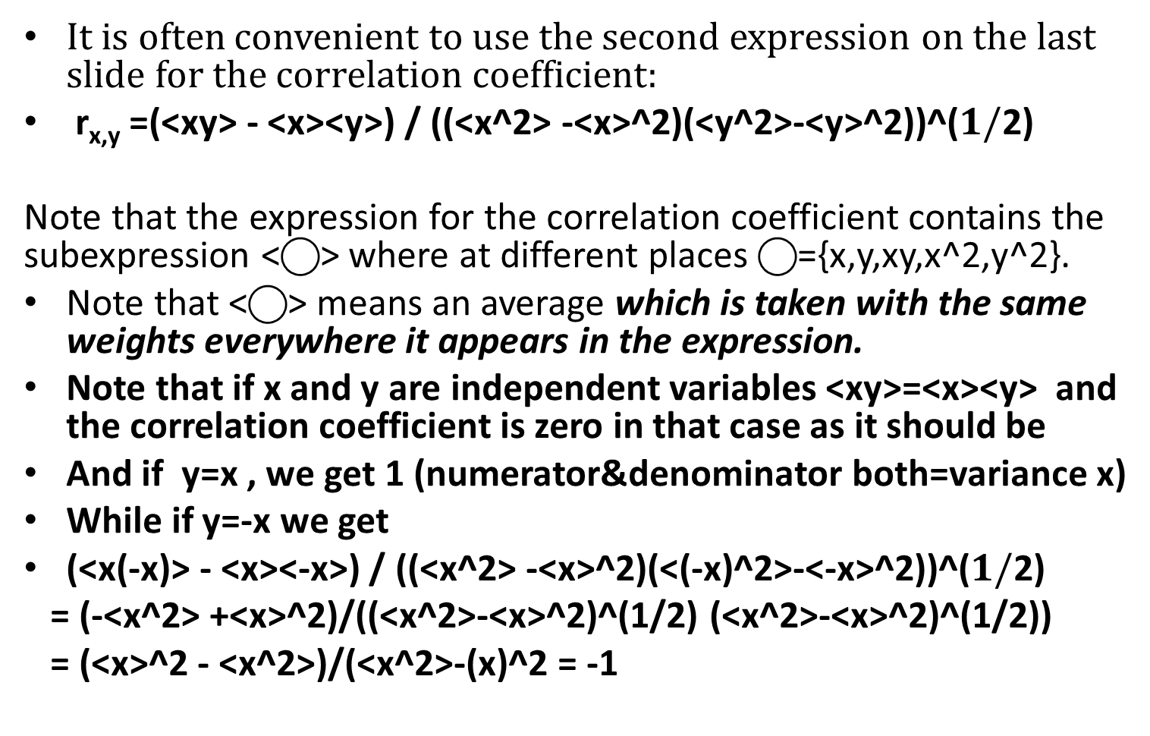
Correlation Coefficient is built of means.
It is often convenient to use the second expression on the last slide for the correlation coefficient:
r_{x,y} =(<xy> - <x><y>) / ((<x^2> -<x>^2)(<y^2>-<y>^2))^(
Note that the expression for the correlation coefficient contains the subexpression <⃝> where at different places ⃝={x,y,xy,x^2,y^2}.
Note that <⃝> means an average which is taken with the same weights everywhere it appears in the expression.
Note that if x and y are independent variables <xy>=<x><y> and the correlation coefficient is zero in that case as it should be
And if y=x , we get 1 (numerator&denominator both=variance x)
While if y=-x we get
(<x(-x)> - <x><-x>) / ((<x^2> -<x>^2)(<(-x)^2>-<-x>^2))^(
= (-<x^2> +<x>^2)/((<x^2>-<x>^2)^(1/2) (<x^2>-<x>^2)^(1/2))
= (<x>^2 - <x^2>)/(<x^2>-(x)^2 = -1

Slide 6
Analogy to vector geometry
If {x_{i}} for i=1 to n is a set of data on a variable x
and <x> = Σ w’_{i} x_{i} is its mean
(w’_{i} = w_{i}/Σ w’_{I} are the normalized weights),
Then {x_{i} - <x>} is the set of deviations of the variable x from its mean
and the variance of x: <(x_{i} - <x>)²> = Σ w’_{i} (x_{i} - <x>)²
is analogous to the usual formula for the square of the vector of x deviations (x_{i} - <x>)in an n dimensional space, only that the normalized weights w’_{i} = appear making some “dimensions” (data points) more important than others . This amounts to having different scales on the different axes of the n-dimensional space.
And the standard deviation of x: <(x_{i} - <x>)²>^{1/2}
Is analogous to the length of the vector of deviations.

Slide 7
Covariance analogous to dot product
If {y_{i}} i=1 to n is a set of data for a second variable y
And we likewise consider y’s deviations from y’s mean a second vector in the n dimensional space (one dimension for each data point): (y_{i} - <y>)
Then the covariance of x and y:
<(x_{i} - <x>) (y_{i} - <y>)> = Σ w’_{i} (x_{i} - <x>) (y_{i} - <y>)
is analogous to the dot product of the vector of x deviations and the vector of y deviations in n-space.

Slide 8
Correlation Coefficient analogous to cosine of angle between vectors
The Correlation Coefficient of x and y
r_{x,y} = <(x-<x>)(y-<y>)> / (<(x-<x>)^2> <(y-<y>)^2>)^(1/2)
Is analogous to the ratio of the dot product of the vector of x deviations and the vector of y deviations divided by the product of their lengths. This is the formula for the cosine of an angle.
So the Correlation Coefficient represents the cosine of the angle between two variables deviations from mean, taken as vectors in an abstract space.
The cosine of an angle varies from +1 (zero degrees separation) to -1(180 degrees separation) this is why
+1 ≥r_{x,y} ≥-1
When the Correlation Coefficient = +1, the 2 variables have vectors of deviations pointing in the same direction, the variables “go together”.
When the correlation coefficient = 0 the variables have vectors of deviations which are orthogonal, the variables “ignore each other”.
When the correlation coefficient = -1 they have vectors of deviations pointing in opposite directions, the variables “go against each other”.
The correlation coefficient is thus a measure of the relationship between the variables.

Slide 10
Correlation of K_H and Ri
For heat diffusivity(K_H) and Richardson number(Ri) we have
r_{K_H,Ri} = (<K_H*Ri> - <K_H><Ri>) /
((<K_H^2> -<K_H>^2)^(1/2)(<Ri^2>-<Ri>^2)^(1/2))
If K_H almost always increased when Ri increased and decreased when Ri decreased the Correlation Coefficient would be close to one,
While if the way K_H varied and the way Ri varied had little to do with one another the Correlation Coefficient would be close to zero,
But if generally K_H decreases with increasing Ri and vice-a-versa, as we expect because K_H, the heat mixing, is suppressed by stratification represented by Ri, the Correlation Coefficient should be significantly negative.
Homework#8 is to write a matlab program to calculate the standard deviations of K_H and Ri and the correlation coefficient r_{K_H,Ri} , building on your program for Homework#2 and run it on the data in <file to be provided>.
Submit both the program and the numbers you got.

